Slide 1
Chapter 4
Threads

Slide 2
Outline and Objectives
Outline
Overview
Multithreading Models
Thread Libraries
Threading Issues
Operating System Examples
Windows XP Threads
Linux Threads
Re-entrency
Thread specific data
Objectives
To introduce the notion of a thread — a fundamental unit of CPU utilization that forms the basis of multithreaded computer systems
To discuss the APIs for the Pthreads, Win32, and Java thread libraries
To examine issues related to multithreaded programming

Slide 3
Threading Concept

Slide 4
Threads and Thread Usage
A process has normally a single thread of control (execution sequence/flow).
  Always at least one thread exists
  If blocks, no activity can be done as part of the process
  Better: be able to run concurrent activities (tasks) as part of the same process.
  Now, a process can have multiple threads of control (multiple concurrent tasks).
Threads run in pseudo-parallel manner (concurrently), share text and data
Responsiveness
  One thread blocks, another one runs.
  One thread may always wait for the user
Resource Sharing
  Threads can easily share resources
Economy
  Creating a thread is fast
  Context switching among threads may be faster
Scalability
  Multiprocessors can be utilized better

Slide 5
Threads and Thread Usage
data
data
CPU
blocks
blocks
blocks
code
blocks
code
run enough
single-threaded process
multi-threaded process

Slide 6
a multithreaded process’ execution flows: threads
Instructions of the Program
main()
Thread0
Thread2
Thread1
time
Lifetime of the process

Slide 7
Multithreading Concept
CPU
single-threaded process
multi-threaded process

Slide 8
Multithreading Concept
Process
Process
thread
thread
thread
thread
P1.T1
P2.T1
P2.T2
P2.T3
Schedulable Entities
We can select one of them and run

Slide 9
Multithreading Concept
thread1
thread2
thread3
thread4
function1(…)
{
….
{
function2(…)
{
….
{
main()
{ ….
thread_create (function1 ,…);
….
thread_create (function2, …);
….
thread_create (function1, …);
….
}

Slide 10

Single and Multithreaded Processes

Slide 11
Multicore programming and multithreading challenges
Multicore systems putting pressure on programmers.
  Threading can utilize Multicore systems better, but it has come challenges
Threading Challenges include
  Dividing activities
    Come up with concurrent tasks
  Balance
    Tasks should be similar importance and load
  Data splitting
    Data may need to be split as well
  Data dependency
    Data dependencies should be considered; need synchronization of activities
  Testing and debugging
    Debugging is more difficult

Slide 12

Multithreaded Server Architecture

Slide 13
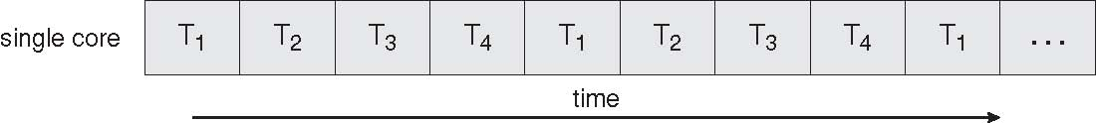
Concurrent Execution on a Single-core System

Slide 14
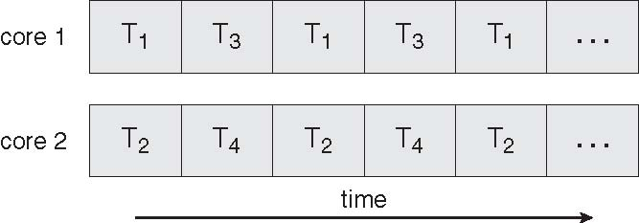
Parallel Execution on a Multicore System

Slide 15
Threading Support

Slide 16
Threading Support
Multithreading can be support by:
  User level libraries (without Kernel being aware of it)
    Library creates and manages threads (user level implementation)
  Kernel itself
    Kernel creates and manages threads (kernel space implementation)
No matter which is implemented, threads can be created, used, and terminated via a set of functions that are part of a Thread API (a thread library)
  Three primary thread libraries: POSIX threads, Java threads, Win32 threads

Slide 17
Multithreading Models
A user process wants to create one or more threads.
  Kernel can create one (or more) thread(s) for the process.
    Even a kernel does not support threading, it can create one thread per process (i.e. it can create a process which is a single thread of execution).
Finally a relationship must exist between user threads and kernel thread(s)
  Mapping user level threads to kernel level threads
Three common ways of establishing such a relationship:
  Many-to-One model
  One-to-One model
  Many-to-Many model

Slide 18
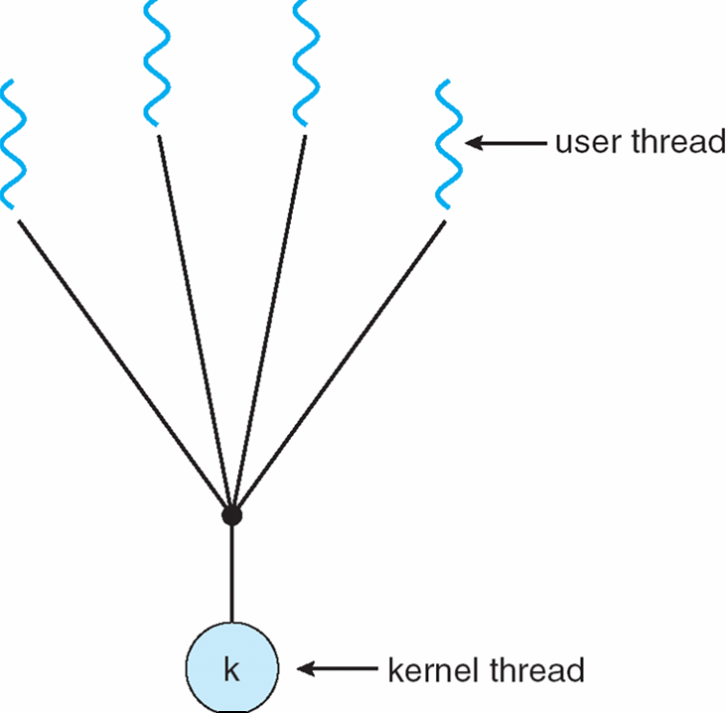
Many-to-One Model:
Implementing Threads in User Space
Many user-level threads
mapped to a single kernel thread
Examples:
  Solaris Green Threads
  GNU Portable Threads
Thread management
done at user space, by a
thread library
Kernel supports process concept;
not threading concept

Slide 19
Many-to-One Model:
Implementing Threads in User Space
No need for kernel support for multithreading (+)
Thread creation is fast (+)
Switching between threads is fast; efficient approach (+)
Blocking systems calls defeat the purpose and have to be handled (-)
A thread has to explicitly call a function to voluntarily give the CPU to some other thread (-)
  example: thread_yield()
Multiple threads will run on a single processor, not utilizing multi-processor machines. (-)
Thread
Process A
Process B
Run-time
System (library)
Thread
table
PCB A
PCB B
Kernel
process table

Slide 20
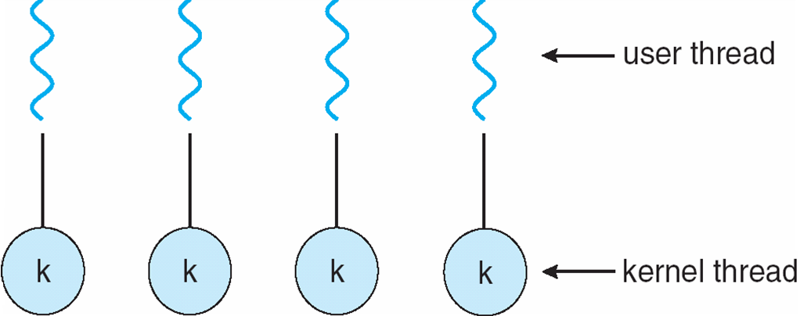
One-to-One Model:
Implementing Threads in Kernel Space
Kernel may implement threading and can manage threads, schedule threads. Kernel is aware of threads.
Examples (nearly all modern OSs): Windows, Linux, …
  All these kernels have threading support. They can schedule processes and their threads (not only processes)
Each user-level thread maps to a kernel thread

Slide 21
One-to-One Model:
Implementing Threads in Kernel Space
Provides more concurrency; when a thread blocks, another can run. Blocking system calls are not problem anymore. Multiple processors can be utilized as well. (+).
Kernel can stop a long running thread and run another thread. No need for explicit request from a thread to be stopped. (+)
Need system calls to create threads and this takes time; thread switching costly; any thread function requires a system call. (-)
Process A
Process B
PCB A
PCB B
Kernel
process table
Thread table

Slide 22

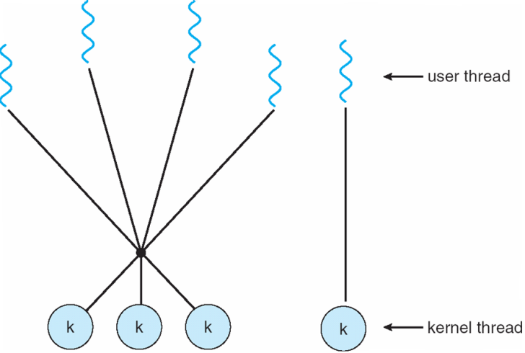
Many-to-Many Model & Two-level Model
Many-to-Many Model
Allows many user level threads to be mapped to many kernel threads
Allows the operating system to create a sufficient number of kernel threads
Solaris prior to version 9
Windows NT/2000 with the ThreadFiber package
Two-level Model
Similar to M:M, except that it allows a user thread to be bound to a kernel thread
Examples
  IRIX
  HP-UX
  Tru64 UNIX
  Solaris 8 and earlier

Slide 23
Threading API

Slide 24
Thread Libraries
Thread library provides programmer with API for creating and managing threads
  Programmer just have to know the thread library interface (API).
  Threads may be implemented in user space or kernel space.
    library may be entirely in user space or may get kernel support for threading

Slide 25
Pthreads Library
May be provided either as user-level or kernel-level
A POSIX standard (IEEE 1003.1c) API for thread creation and synchronization
API specifies behavior of the thread library, implementation is up to development of the library
Common in UNIX operating systems (Solaris, Linux, Mac OS X)

Slide 26
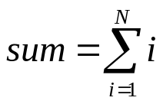
Pthreads Example
We will show a program that creates a new thread.
  Hence a process will have two threads :
    1 - the initial/main thread that is created to execute the main() function (that thread is always created even there is no support for multithreading);
    2 - the new thread.
    (both threads have equal power)
The program will just create a new thread to do a simple computation. The new thread will get a parameter, an integer value (as a string), and will sum all integers from 1 up to that value.
  sum = 1+2+…+parameter_value
The main thread will wait until sum is computed into a global variable.
Then the main thread will print the result.

Slide 27
Pthreads Example
#include <pthread.h>
#include <stdio.h>
int sum; /* shared sum by threads – global variable */
void *runner (void *param); /* thread start function */

Slide 28
Pthreads Example
int main(int argc, char *argv[]){
pthread_t tid; /* id of the created thread */
pthread_attr_t attr; /* set of thread attributes */
if (argc != 2) {
fprintf (stderr, “usage: a.out <value>\n”);
return -1;
}
if (atoi(argv[1]) < 0) {
fprintf (stderr, “%d must be >= 0\n”, atoi(argv[1]);
return -1;
}
pthread_attr_init (&attr);
pthread_create (&tid, &attr, runner, argv[1]);
pthread_join (tid, NULL);
printf (“sum = %d\n”, sum);
}

Slide 29
Pthreads Example
void *runner (void *param)
{
int i;
int upper;
upper = atoi(param);
sum = 0;
for (i = 1; i <= upper; ++i)
sum += i;
pthread_exit(0);
}

Slide 30
Pthreads Example
int main(…)
{
…
….
pthread_create(&tid,…,runner,..);
pthread_join(tid);
. printf (…, sum, …);
}
runner (…)
{
….
sum = …
pthread_exit();
{
thread1
thread2
wait

Slide 31
Compiling and running the program
You can put the above code into a .c file, say mysum.c
In order to use the Pthreads functions, we need to include pthread.h header file in our program (as shown in previous slides)
We also need to link with the pthread library (the Pthreads API functions are not implemented in the standard C library). The way to do that is using the –l option of the C compiler. After –l you can provide a library name like pthread.
Hence we can compile+link our program as follows:
  gcc -Wall -o mysum -lpthread mysum.c
Then we run it as (for example):
  ./mysum 6
It will print out 21

Slide 32
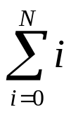
Thread Libraries
POSIX Pthreads library may be provided as either a user-or kernel-level library
The Win32 thread library is a kernel level library available on Windows
Java thread API allows thread creation and management directly in Java programs, but since JVM is running on top of a host OS, the Java thread API is implemented using a thread library on the host (e.g. Win32)
We will examine these three thread libraries. We design a multithreaded program that performs the summation of a non-negative integer in a separate thread using the summation function:
sum =

Slide 33
Multithreaded C program using Pthreads API
#include <pthread.h>
#include <stdio.h>
int sum; /* this data is shared by the thread(s) */
void *runner(void *param); /* the thread */
int main(int argc, char *argv[])
{
pthread_t tid; /* the thread identifier */
pthread_attr_t attr; /* set of thread attributes */
if (argc != 2) {
fprintf(stderr, “usage: a.out < integer value>\n”);
return -1;
}
if (atoi(argv[1]) < 0) {
fprintf(stderr, “%d must be >= 0\n”, atoi(argv[1]));
return -1;
}

Slide 34
Multithreaded C program using Pthreads API
/* get the default attributes */
pthread_attr_init(&attr);
/* create the thread */
pthread_create(&tid, &attr, runner, argv[1]);
/* wait for the thread to exit */
pthread_join(tid, NULL);
printf(“sum = %d\n”, sum);
}
/* The thread will begin control in this function */
void *runner(void *param)
{
int i, upper = atoi(param);
sum = 0;
for (i = 1; i <= upper; i++)
sum += i;
pthread_exit(0);
}

Slide 35
Multithreaded C program using the Win32 API
#include <windows.h>
#include <stdio.h>
DWORD Sum; /* data is shared by the thread(s) */
/* the thread runs in this separate function */
DWORD WINAPI Summation(LPVOID Param)
{
DWORD Upper = *(DWORD*)Param;
for (DWORD i = 0; i <= Upper; i++)
Sum += i;
return 0;
}
int main(int argc, char * argv[])
{
DWORD ThreadId;
HANDLE ThreadHandle;
int Param;
/* perform some basic error checking */
if (argc != 2) {
fprintf(stderr, “An integer parameter is required\n”);
return -1;
}
Param = atoi(argv[1];

Slide 36
Multithreaded C program using the Win32 API
// create the thread
ThreadHandle = CreateThread(
NULL, // default security attributes
0, // default stack size
Summation, // thread function
&Param, // parameter to thread function
0, // default creation flags
&ThreadId); // returns the thread identifier
if (ThreadHandle != NULL) {
// now wait for the thread to finish
WaitForSingleObject(ThreadHandle, INFINITE);
// close the thread handle
CloseHandle(ThreadHandle);
printf(“Sum = %d\n”, Sum);
}
}

Slide 37
Java program for the summation example
class Sum {
private int sum;
public int getSum() {
return sum;
}
public void setSum(int sum) {
this.sum = sum;
}
}
class Summation implements Runnable {
private int upper;
private Sum sumValue;
public Summation(int upper, Sum sumValue) {
this.upper = upper;
this.sumValue = sumValue;
}
public void run() {
int sum = 0;
for (int i = 0; i <= upper; i++)
sum += i;
sumValue.setSum(sum);
}
}

Slide 38
Java program for the summation example
Public class Driver
{
public static void main(String[] args) {
if (arg.length > 0) {
if (Integer.parseInt(args[0]) < 0)
System.err.println(args[0] + “ must be >= 0.”);
else {
// create the object to be shared
Sum sumObject = new Sum();
int upper = Integer.parseInt(args[0]);
Thread thrd = new Thread(new Summation(upper, sumObject));
thrd.start();
try {
thrd.join();
System.out.println
(“The sum of “+upper+” is “+sumObject.getSum());
} catch (InterruptedException ie) { }
}
}
else
System.err.println(“Usage: Summation < integer value>”);
}
}

Slide 39
Java
There are two techniques for creating threads in a Java program
  Create a new class that is derived from the Thread class and to override its run() method.
  Define a class that implements the Runnable interface.
  public interface Runnable
  {
  public abstract void run();
  }
  The code implementing the run() method is what runs as a thread
The specification for the JVM does not indicate how Java threads are to be mapped to the underlying OS.
  Windows XP uses the one-to-one model.
  There may be a relationship between the Java thread library and the thread library on the host OS.
    For windows Win32 API can be used when creating Java threads.
    Linux and Solaris systems might use Pthreads API.

Slide 40
Sharing of Data
Occurs easily in Win32 and Pthreads, as shared data are simply declared globally.
As a pure object-oriented language, Java has no such notion of global data; if two or more threads are to share data in a Java program, the sharing occurs by passing reference to the shared object to the appropriate threads.
  In the example program, the main thread and the summation thread share the object instance of the Sum class which is referenced through the appropriate getSum() and setSum() methods.

Slide 41
Other Threading Issues

Slide 42
Java Threads
Java threads are managed by the JVM
Typically implemented using the threads model provided by underlying OS
Java threads may be created by:
  Extending Thread class
  Implementing the Runnable interface

Slide 43
Threading Issues
Semantics of fork() and exec() system calls
Thread cancellation of target thread
  Asynchronous or deferred
Signal handling
Thread pools
Thread-specific data
Scheduler activations

Slide 44
Semantics of fork() and exec()
Does fork() duplicate only the calling thread or all threads?
How should we implement fork?
logical thing to do is:
  1) If exec() will be called after fork(), there is no need to duplicate the threads. They will be replaced anyway.
  2) If exec() will not be called, then it is logical to duplicate the threads as well; so that the child will have as many threads as the parent has.
So we may implement two system calls: like fork1 and fork2!

Slide 45
Thread Cancellation
Terminating a thread before it has finished
  Need at various cases
Two general approaches:
  Asynchronous cancellation terminates the target thread immediately
  Deferred cancellation allows the target thread to periodically check if it should be cancelled
    Cancelled thread has sent the cancellation request

Slide 46
Signal Handling
If a signal is send to Multithread Process, who will receive and handle that?
In a single thread process, it is obvious.

Slide 47
Thread Pools
Create a number of threads in a pool where they await for work
Advantages:
  Faster
  Limit the count of threads:
    Allows the number of threads in the application to be bound to the size of the pool

Slide 48
From Single-threaded to Multithreaded
Many programs are written as a single threaded process.
If we try to convert a single-threaded process to multi-threaded process, we have to be careful about the following:
  the global variables
  the library functions we use

Slide 49
From Singlethread to Multithreaded
int status; // a global variable
func1(…) {
….
status = …
do_something_based_on(status);
}
func2(…) {
…
status = …
do_something_based_on(status);
}
main() {
….
func1 (…);
func2 (…);
}
This is a
single threaded
program

Slide 50
From Singlethread to Multithreaded
int status;
func1(…) {
….
status = …
do_something_based_on(status);
}
func2(…) {
…
status = …
do_something_based_on(status);
}
main() {
….
thread_create(…, func1, …);
thread_create(…, func2, …);
}
We can have problem here.
Just after func1 of thread 1 updated status, a thread switch may occur and 2nd thread can run and update status.
Then thread 1 will run again, but will work with a different status value.
Wrong result!

Slide 51
From Single-threaded to Multithreaded
Scope of variables:
  Normally we have: global, local
  With threads we want: global, local, thread-local
thread-local: global inside the thread (thread-wide global), but not global for the whole process. Other threads can not access it. But all functions of the thread can.
But we don’t have language support to define such variables.
  C can not do that.
Therefore thread API has special functions that can be used to create such variables – data.
  This is called thread specific data.

Slide 52
Thread Specific Data
Allows each thread to have its own copy of data
  Each thread refers to the data with the same name.
create_global (“bufptr”); // create pointer to such a variable
set_global (“bufptr”, &buf); // set the pointer
bufptr = read_global (“bufptr”); // get the pointer to access

Slide 53
From Singlethread to Multithreaded
Many library procedures may not be reentrant.
  They are not designed to have a second call to itself from the same process before it is completed (not re-entrant).
    (We are talking about non-recursive procedures.)
  They may be using global variables. Hence may not be thread-safe.
We have to be sure that we use thread-safe (reentrant) library routines in multi-threaded programs we are developing.

Slide 54
Examples from Operating Systems

Slide 55
Operating System Examples
Windows XP Threads
Linux Threads

Slide 56
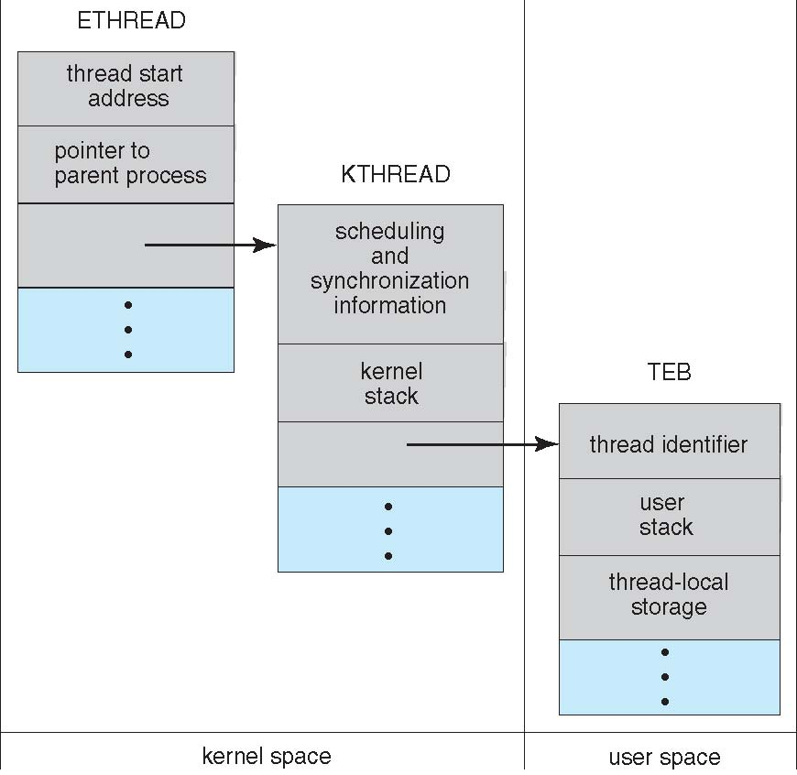
Windows XP Threads

Slide 57
Windows XP Threads
Implements the one-to-one mapping, kernel-level
Each thread contains
  A thread id
  Register set
  Separate user and kernel stacks
  Private data storage area
The register set, stacks, and private storage area are known as the context of the threads
The primary data structures of a thread include:
  ETHREAD (executive thread block)
  KTHREAD (kernel thread block)
  TEB (thread environment block)

Slide 58
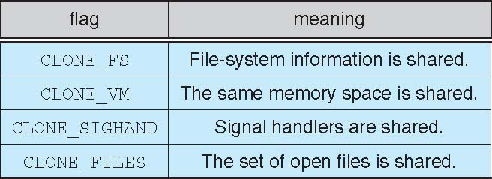
Linux Threads
Linux refers to them as tasks rather than threads
Thread creation is done through clone() system call
clone() allows a child task to share the address space of the parent task (process)

Slide 59
Clone() and fork()
user program
library
sys_fork()
sys_clone()
sys_fork()
{
…
}
sys_clone(){
….
}
kernel

Slide 60
References
The slides here are adapted/modified from the textbook and its slides: Operating System Concepts, Silberschatz et al., 7th & 8th editions, Wiley.
Operating System Concepts, 7th and 8th editions, Silberschatz et al. Wiley.
Modern Operating Systems, Andrew S. Tanenbaum, 3rd edition, 2009.

Slide 61
Additional Study Material

Slide 62
Signal Handling
Signals are used in UNIX systems to notify a process that a particular event has occurred
  They are notifications
a Signal:
  Signal is generated by a particular event
  Signal is delivered to a process (same or different process)
  Signal is handled
A signal handler is used to process signals
Handled asynchronously

Slide 63
Signal Handling
Options:
  Deliver the signal to the thread to which the signal applies
  Deliver the signal to every thread in the process
  Deliver the signal to certain threads in the process
  Assign a specific thread to receive all signals for the process

Slide 64
a C program using signals
#include <stdio.h>
#include <signal.h>
#include <stdlib.h>
static void sig_int_handler() {
printf("I received SIGINT signal. bye... \n");
fflush(stdout);
exit(0);
}
int main() {
signal (SIGINT, sig_int_handler);
while (1)
;
}
While a program is running, if we press CTRL-C keys, the program will be terminated (killed). We are sending a SIGINT signal to the program
By default, SIGINT is handled by kernel. By default, kernel terminates the program.
But if we specify a handler function as here, then our program can handle it.
Kernel will notify our process with a signal when user presses the CTRL-C keys.
Program X

Slide 65
delivering signal (notifying)
Program X
signal handler run
SIGINT signal delivered
Kernel
CTRL-C
Keyboard

Slide 66
kill program
process id = 3405
kill -s SIGINT 3405
Program X
signal handler run
SIGINT signal is delivered
Kernel
SIGINT signal is stored in PCB of X
Keyboard

Slide 67
Some Signals
SIGABRT Process abort signal.
SIGALRM Alarm clock.
SIGBUS Access to an undefined portion of a memory object.
SIGCHLD Child process terminated, stopped, or continued.
SIGCONT Continue executing, if stopped.
SIGFPE Erroneous arithmetic operation.
SIGHUP Hangup.
SIGILL Illegal instruction.
SIGINT Terminal interrupt signal.
SIGKILL Kill (cannot be caught or ignored).
SIGPIPE Write on a pipe with no one to read it.
SIGQUIT Terminal quit signal.
SIGSEGV Invalid memory reference.
SIGSTOP Stop executing (cannot be caught or ignored).
SIGTERM Termination signal.

Slide 68
Scheduler Activations
Kernel threads are good, but they are slower if we create short threads too frequently, or threads wait for each other too frequently.
Is there a middle way?
  Schedule Activation
Goal is mimic kernel threads at user level with some more kernel support. But kernel will not create another thread for each user thread (M:1 or M:M model).
Avoid unnecessary transitions between user and kernel space.

Slide 69
Scheduler Activations: Upcall mechanism
upcall handler can
re-start the 1st thread
threads
Process
Run-time
System
(i.e. thread library)
upcall handler
schedules
another thread
Thread
table
library registers a handler
(upcall handler)
when
process/thread
is started
makes system call
kernel runs the upcall handler
(i.e. makes an upcall; activates
the user level scheduler)
Kernel
Kernel initiates I/O
and blocks the thread
kernel detects that I/O is finished
kernel informs the library via upcall

